Slide 1
Why the A.R.T. of Examination (in Msk Med)?
Geoff Harding

Slide 2
TWO APPROACHES
GP can be actively involved in the management of the musculoskeletal patient
OR, can pass onto allied health for management
Two approaches means differing emphases.

Slide 3
“Look, Feel, Move”
The traditional ahphorism of Apley
The essentials of EXAMINATION
Accepted by Orthopaedic Surgeons.
EXAMINATION is essential in many other disciplines
Why not in Musculoskeletal Medicine?
EBM

Slide 4
Clinical Epidemiology
Clinical epidemiology is not medical epidemiology as we understand it
It represents the philosophical and rational basis for determining truth in the practice of medicine (Sackett et al 1991)
The particular truths that are relevant to us are
RELIABILITY
VALIDITY
EFFICACY

Slide 5
The Problem with EBM in MSM
Pain is the most common symptom in Musculoskeletal medicine
Pain is a subjective complaint
There is no “pain-o-gram”
Pain pathways are very complex
The phenomenon of referred pain - God’s sense of humour GAH
Problem of shifting sands in examining anatomical structures
Problem of examiner expertise vs novice or “klutz”
Eg compare listening to heart sounds or breath sounds with palpating for hypomobility in an intervertebral joint

Slide 6
EBM is not very kind to MSM
Lots of trials show poor validity - ie low LRs
Lots of trials show low kappa scores - ie poor reliability
So why do a physical examination if .. - the test is not going to be diagnostic - and/or the test can’t be reproduced by the majority of docs?

Slide 7
Sackett
a rational approach to a patient with spinal pain involves “integrating individual clinical expertise with the best available external clinical evidence from systematic research”
Sackett DL, Richardson WS, Rosenberg W, Haynes RB. Evidence-based Medicine. How to Practice and Teach EBM. Churchill Livingstone, Edinburgh, 1997; p 2.

Slide 8
Examination? -Someone’s gotta do it!
Slippery slope argument but has truth in it nevertheless
What are we looking for? - T.A.R.T.
If no one performed an examination, what would we miss?
How can we rely on another practitioner’s diagnosis if there is no standard approach
Can we be sure someone has actually performed a complete examination before us?
Notes:
TART = Tenderness, Asymmetry, ROM abnormalities, and Tissue texture abnormalities

Slide 9
Examination should increase the probability of one diagnosis
And should help exclude other (msk) diagnoses
Notes:
We don’t expect to make the diagnosis on the basis of the examination alone – though some are “spot” diagnoses.

Slide 10
Tenderness
Is it important?
“Doc, when you do that, it gives me my pain! No one has been able to find it before”
Notes:
If I had someone complaining of a pain problem and I couldn’t find any tenderness at all, I would be unnerved. Yes there can be tenderness which is not relevant but that’s when experience comes in – knowing what’s normal and what’s not.

Slide 11
Tenderness
The finding of tenderness puts the patient in control (to some extent) of his pain problem
You can’t trick the patient into feeling pain
Lessens the chance of “guruism”

Slide 12
Need Experience
Ende: we are losing clinical skills because not enough emphasis is placed on examination
Practice makes perfect
Some conditions are purely clinical – a stroke is a stroke even if the CT is normal
HOWEVER- “A physical exam maneuver should be assessed as we assess any diagnostic test, based upon its reliability, accuracy and diagnostic value”.
JACK ENDE and (by invitation) KEVIN M. FOSNOCHT CLINICAL EXAMINATION: STILL A TOOL FOR OUR TIMES? TRANSACTIONS OF THE AMERICAN CLINICAL AND CLIMATOLOGICAL ASSOCIATION, VOL. 113, 2002
Notes:
How useful would it be if a vet didn’t know how to palpate a bladder to diagnose urethral obstruction in an elderly male cat? You can’t just send everyone off for an ultrasound.

Slide 13
Oxytocin
The “feel-good” hormone
released into the blood from the posterior lobe (neurohypophysis) of the pituitary gland
Increases with touch (laying on of hands)
Many studies have already shown a correlation of oxytocin with human bonding, increases in trust, and decreases in fear
“Transference”

Slide 14
Stefan Blomberg
Stefan Blomberg’s paradigm can be summarised as being “treat with manual therapy so that you can then go on and get inside their head”.
The therapist (in the paradigm) is a bone-setter and a shrink at the same time.

Slide 15
Range of Movement
Easy to comprehend with large joints (eg hip, knee, frozen shoulder)
Components needed to be distinguished are joint (bony) restriction, muscle shortening, limitation due to pain.
VIz “capsular pattern” of restriction
Skill in the technique can sort these differing issues out
Less easy to appreciate with small (intervertebral, zygapophyseal) joints
However, the more you practise, the more skilled you become

Slide 16
Active vs Passive ROM
Gives different information
Need practice
Degree of effort etc
Restriction due to pain vs Restriction due to weakness

Slide 17
Follow-up
The examination findings can be referred to at a later stage to assess response to treatment or progression of the “disease”
Eg degree of tenderness
Level of palpation
Range of Movement
Presence/absence of “spasm”
Otherwise have to rely solely on pain ratings, functional ratings etc (Problem with much chronic pain assessment – GAH)
Gives the therapist confidence in his/her skills to be able to compare and contrast and detect improvement/worsening of signs

Slide 18
Other Benefit - Detection of unrelated (but serious) conditions
Parkinson’s Disease, - vascular insufficiency - DVT - melanoma - peptic ulcer - 2° lymphoma in hip joint (nodes) - dissecting aneurysm carotid artery - discitis (fever, looked sick, v tender to percussion) - psoriasis -→ (psoriatic arthropathy) - etc etc etc

Slide 19
Finally
When dealing with PAIN, any examination, history, observation etc is clouded by the subjectivity of the symptom
Dangerous to throw out one of the tools
It all goes into the mix – the diagnostic soup

Slide 20
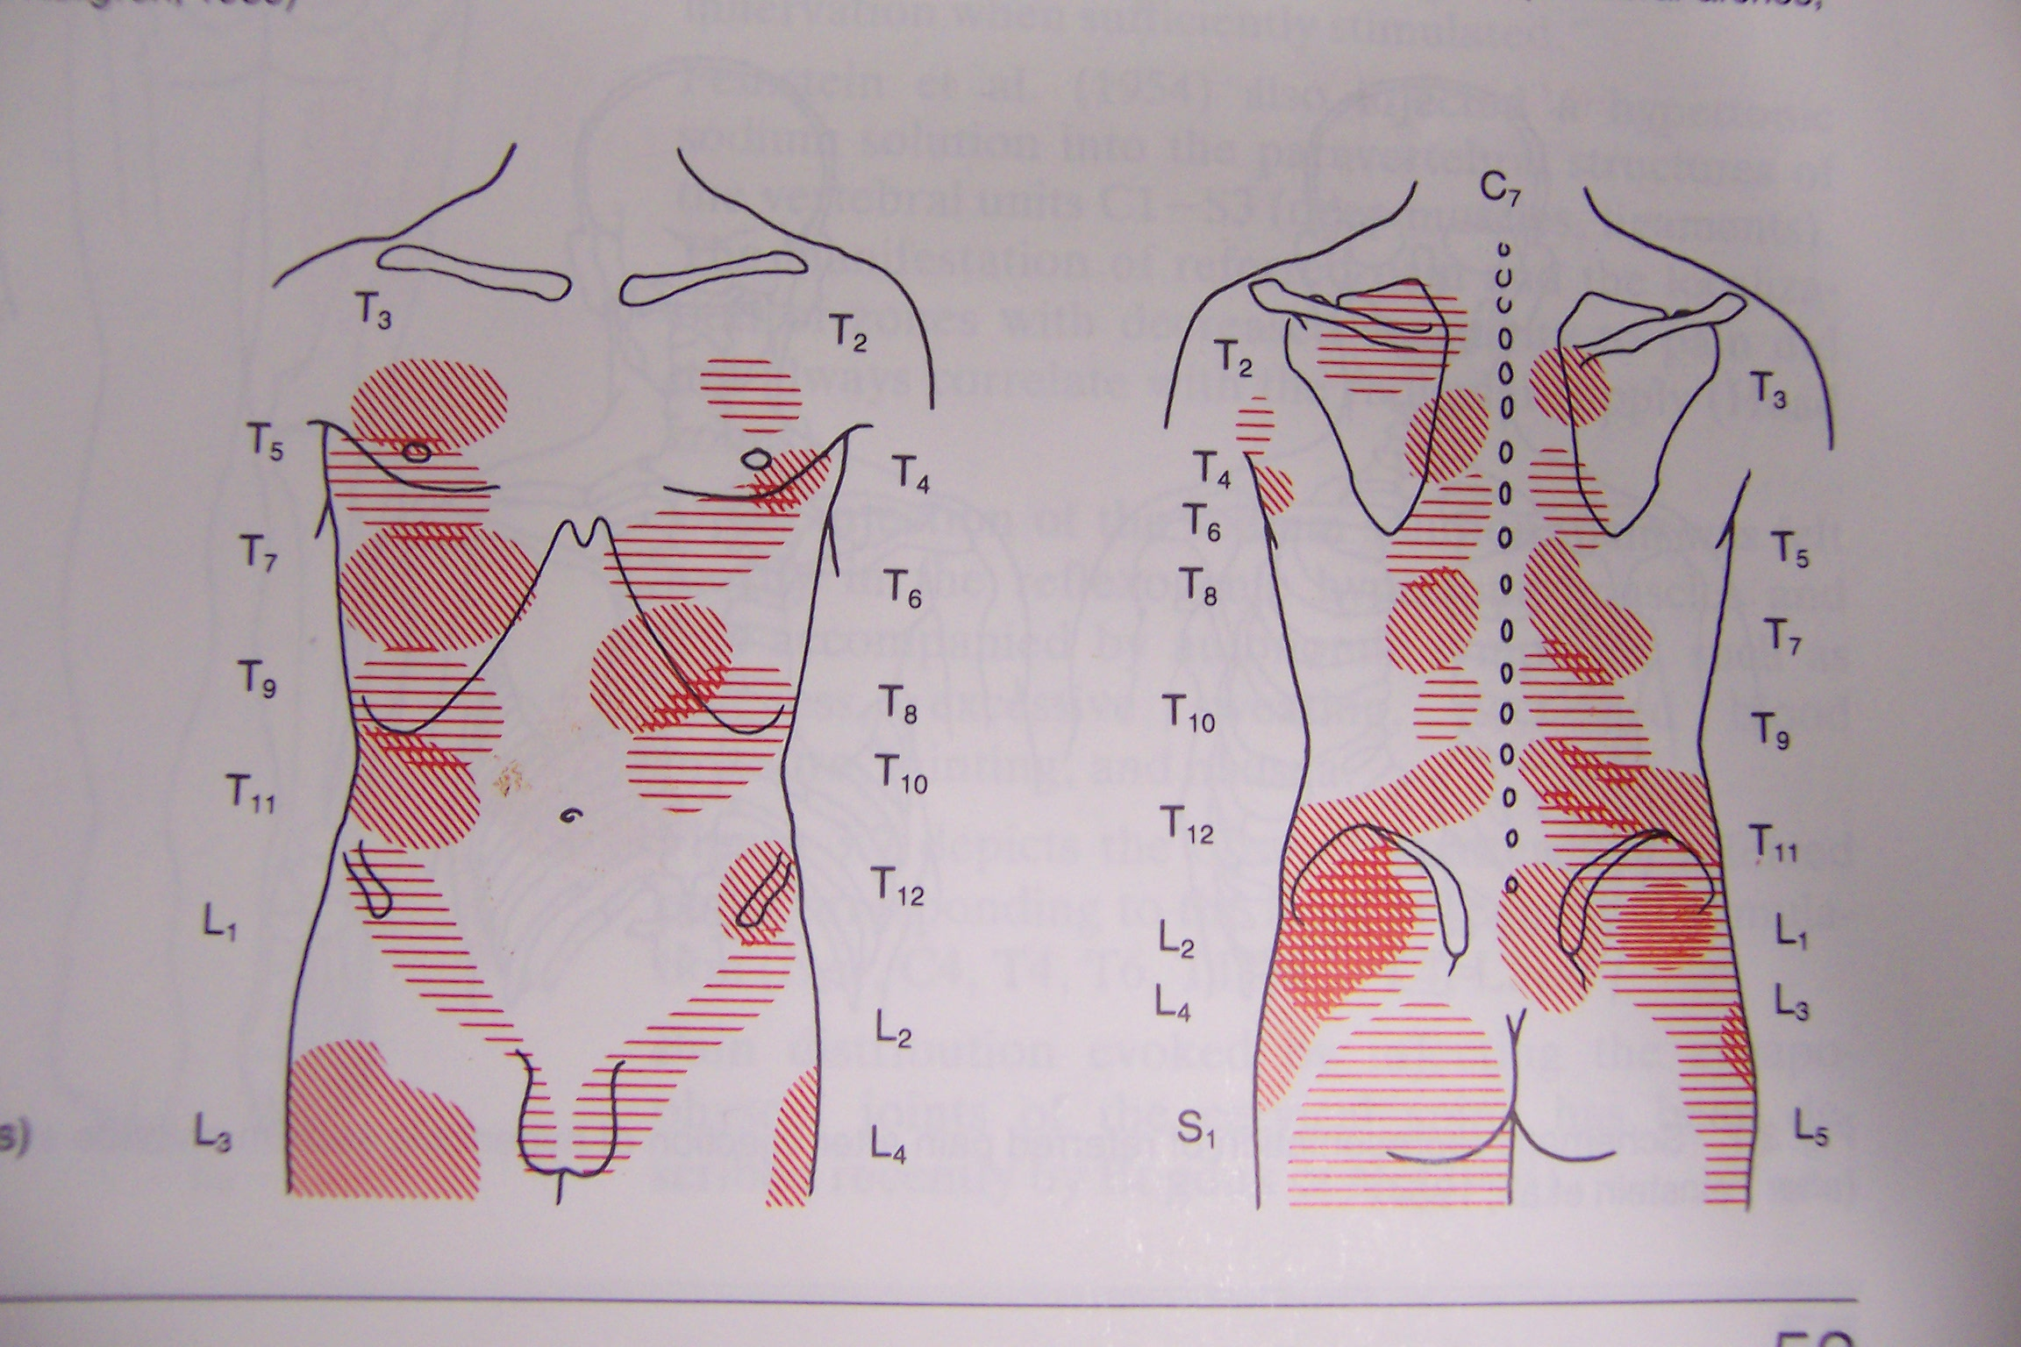
Pain Patterns (Kellgren, Feinstein)

Slide 21
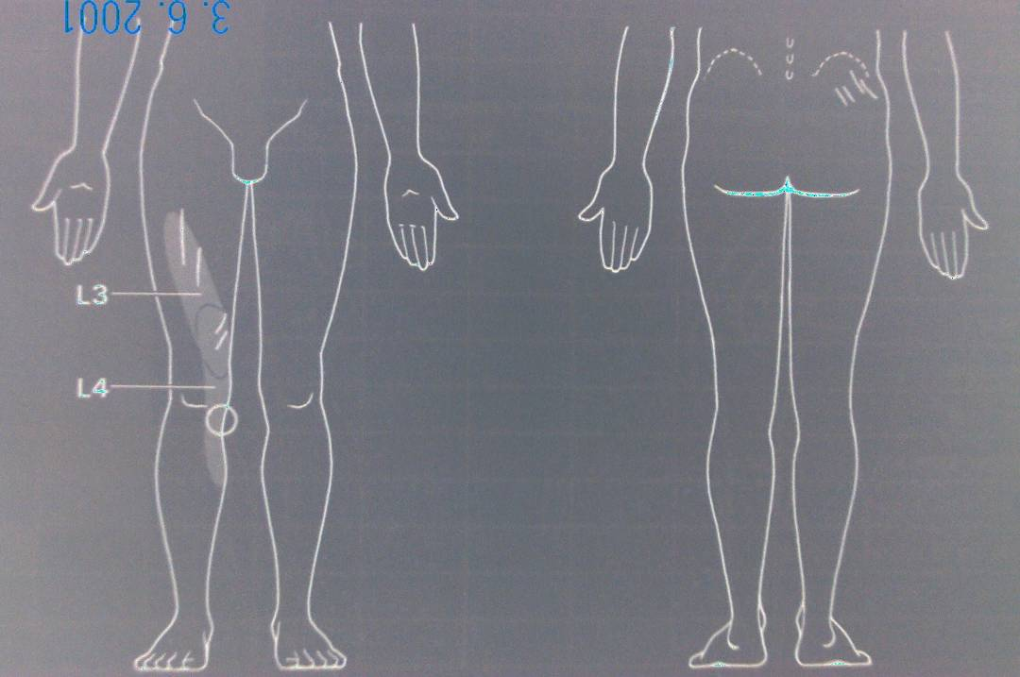
Maigne “Minor Intervertebral Dysfunction”
Pain referred into somatic tissues - skin (hyperalgaesia) - muscle (trig points) - bone (joint)- bony tenderness

